Slide 1
Project 2 - Tasking

Slide 2
Project 2
P2 - Tasking
Change the scheduler from a 2 state to a 5 state scheduler using semaphores with priority queues.
int scheduler() in os345.c
semWait(), semSignal, semTryLock in os345semaphores.c
Tasks are functions and are added to the task scheduler ready queue via the “createTask()” function.
The first task scheduled is your shell from Project 1.
The “SWAP” directive replaces clock interrupts for context switching between tasks (cooperative scheduling).
Context switching directives may be placed anywhere in your user task code.
SWAP, SEM_SIGNAL, SEM_WAIT, SEM_TRYLOCK

Slide 3
Project 2 (continued…)
P2 - Tasking
The highest priority, unblocked, ready task should always be executing.
Tasks of the same priority should be scheduled in a round-robin, FIFO fashion.
Any change of events (SEM_SIGNAL) should cause a context switch.
To simulate interrupts, character inputs and timers need to be “polled” in the scheduling loop.
void pollInterrupts() in OS345p1.c
Parsed command line arguments are passed to tasks (ie. functions) via argc/argv variables.

Slide 4
Step 1: Priority Queue
P2 - Tasking
•••
Priority/TID
Priority/TID
Priority/TID
Priority/TID
# of entries
Create a priority queue
typedef int TID; // task ID
typedef int Priority; // task priority
typedef int* PQueue; // priority queue
PQueue rq; // ready queue
rq = (int*)malloc(MAX_TASKS * sizeof(int));
rq[0] = 0; // init ready queue
Queue functions
int enQ(PQueue q, TID tid, Priority p);
q priority queue (# | pr1/tid1 | pr2/tid2 | …)
tid task id
p task priority
int returned tid
int deQ(PQueue q, TID tid);
q priority queue
tid find and delete tid from q
(tid == -1 → find/delete highest priority)
int deleted tid
(tid == -1 → q task not found)
rq[5]
rq[4] | 10 / 3
rq[3] | 5 / 2
rq[2] | 5 / 0
rq[1] | 2 / 1
rq[0] | 4

Slide 5
Step 2: Schedule w/Ready Queue
P2 - Tasking
•••
Priority/TID
Priority/TID
Priority/TID
Priority/TID
# of entries
Create a ready priority queue
PQueue rq; // ready queue
rq = (int*)malloc(MAX_TASKS * sizeof(int));
rq[0] = 0; // init ready queue
Add new task to ready queue in createTask
enQ(rq, tid, tcb[tid].priority);
Change scheduler() to deQueue and then enQueue next task
if ((nextTask = deQ(rq, -1)) >= 0)
{
enQ(rq, nextTask, tcb[nextTask].priority);
}
rq[5]
rq[4] | 10 / 3
rq[3] | 5 / 2
rq[2] | 5 / 0
rq[1] | 2 / 1
rq[0] | 4

Slide 6
2-State Scheduler
P2 - Tasking
createTask()
dispatch()
killTask()
Ready
Queue
New
Running
Exit
swapTask()
nextTask = enQueue(rq, deQueue(rq, -1));

Slide 7
Step 3: 5-State Scheduling
P2 - Tasking
Add priority queue to semaphore struct
typedef struct semaphore // semaphore
{ struct semaphore* semLink; // link to next semaphore
char* name; // semaphore name (malloc)
int state; // state (count)
int type; // type (binary/counting)
int taskNum; // tid of creator
PQueue q; // blocked queue
} Semaphore;
Malloc semaphore queue in createSemaphore
semaphore->q = (int*)malloc(MAX_TASKS * sizeof(int));
semaphore->q[0] = 0; // init queue
semWait: deQueue current task from ready queue and enQueue in semaphore queue
semSignal: deQueue task from blocked queue and enQueue in ready queue.

Slide 8
5-State Scheduler
P2 - Tasking
#define SWAP swapTask();
#define SEM_WAIT(s) semWait(s);
#define SEM_SIGNAL(s) semSignal(s);
#define SEM_TRYLOCK(s) semTryLock(s);
dispatch()
Ready
Queue
New
Running
Exit
createTask()
swapTask()
killTask()
semSignal()
semWait()
semTryLock()
Blocked
Queues

Slide 9
Task Scheduling
Scheduling
Scheduler / Dispatcher
Ready Priority Queue
Executing
SWAP
SEM_SIGNAL
Semaphore Priority Queue
SEM_WAIT
SEM_SIGNAL
SEM_WAIT
Semaphore Priority Queue
SEM_SIGNAL
Semaphore Priority Queue
SEM_WAIT
…

Slide 10
Step 4a: Counting Semaphore
Project 2 Assignment
Add counting functionality to semaphores
os345semaphores.c: semSignal, semWait, semTryLock
Replace goto temp;
Add a 10 second timer (tics10sec) counting semaphore to the polling routine (os345interrupts.c).
#include <time.h> header.
Call the C function time(time_t *timer).
semSignal the tics10sec semaphore every 10 seconds.
Create a reentrant high priority timing task that
blocks (SEM_WAIT) on the 10 second timer semaphore (tics10sec).
when activated, outputs a message with the current task number and time and then blocks again.

Slide 11
Step 4b: List Tasks
Project 2 Assignment
Modify the list tasks command to
Display all tasks in all system queues in execution/priority order
List task name, if the task is ready, paused, executing, or blocked, and the task priority.
If the task is blocked, list the reason for the block.
Use the project2 command to schedule timer tasks 1 through 9, 2 signal tasks and 2 “ImAlive” tasks.
The tics10sec task about the current time every 10 seconds in a round robin order. (Round Robin)
The “ImAlive” tasks will periodically say hello. (Blocking)
The high priority “Signal” tasks should respond immediately when semaphore signaled. (Priority)

Slide 12
Task Control Block (tcb)
P2 - Tasking
State = { NEW, READY, RUNNING, BLOCKED, EXIT
Priority = { LOW, MED, HIGH, VERY_HIGH, HIGHEST }
// task control block
typedef struct // task control block
{
char* name; // task name
int (*task)(int,char**); // task address
int state; // task state (P2)
int priority; // task priority (P2)
int argc; // task argument count (P1)
char** argv; // task argument pointers (P1)
int signal; // task signals (P1)
// void (*sigContHandler)(void); // task mySIGCONT handler
void (*sigIntHandler)(void); // task mySIGINT handler
// void (*sigKillHandler)(void); // task mySIGKILL handler
// void (*sigTermHandler)(void); // task mySIGTERM handler
// void (*sigTstpHandler)(void); // task mySIGTSTP handler
TID parent; // task parent
int RPT; // task root page table (P4)
int cdir; // task directory (P6)
Semaphore *event; // blocked task semaphore (P2)
void* stack; // task stack (P1)
jmp_buf context; // task context pointer (P1)
} TCB;
Pending semaphore when blocked.

Slide 13
Step 5: Verification
P2 - Tasking
The project2 command schedule timer tasks 1 through 9, 2 signal tasks and 2 “ImAlive” tasks. The tics10sec task about the current time every 10 seconds in a round robin order. The “ImAlive” tasks will periodically say hello. The high priority “Signal” tasks should respond immediately when semaphore signaled.
# | Task Name | Priority | Time slice | Blocking Semaphore
0 | CLI w/pseudo-input interrupts | 5 | 1 | inBufferReady
1-9 | TenSeconds | 10 | 1 | tics10sec
10 | sTask1 | 20 | 1 | sTask10
11 | sTask2 | 20 | 1 | sTask11
12 | ImAlive | 1 | 1 | None
13 | ImAlive | 1 | 1 | None

Slide 14
Step 6: Bonus Credit
P2 - Tasking
Implement a buffered pseudo-interrupt driven character output and demonstrate that it works by implementing a my_printf function.
Implement time slices that adjust task execution times when scheduled.
#include <stdarg.h>
void my_printf(char* fmt, ...)
{ va_list arg_ptr;
char pBuffer[128];
char* s = pBuffer;
va_start(arg_ptr, fmt);
vsprintf(pBuffer, fmt, arg_ptr);
while (*s) putIObuffer(*s++);
va_end(arg_ptr);
} // end my_printf
createTask( "myShell", // task name
P1_shellTask, // task
5, // task priority
argc, // task arg count
argv // task argument pointers
);

Slide 15
setjmp / longjmp
setjmp/longjmp
#include <setjmp.h>
jmp_buf struct
stack pointer (sp), frame pointer (fp), and program counter (pc).
setjmp(jmp_buf env);
saves the program state (sp, fp, pc) in env so that longjmp() can restore them later.
returns 0 value.
longjmp(jmp_buf env, int val);
resets the registers to the values saved in env.
longjmp() returns as if you have just called the setjmp() call that saved env with non-zero value.

Slide 16
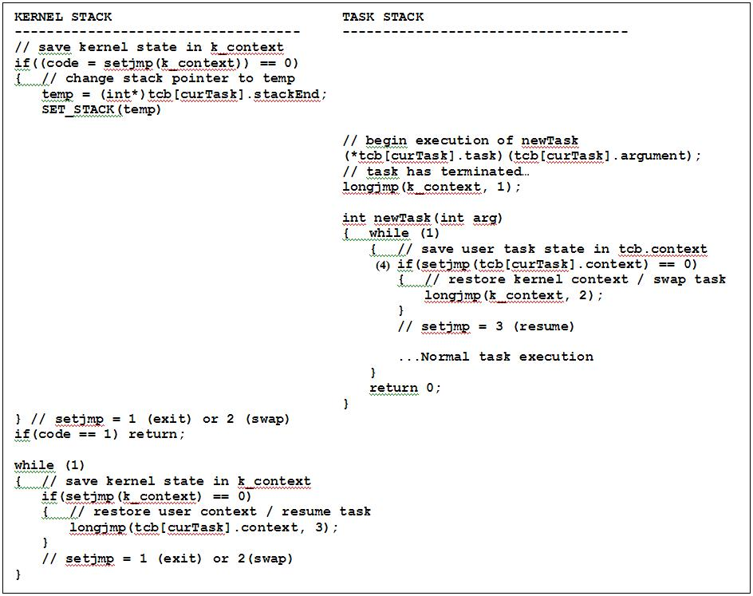
Multi-tasking in C
setjmp/longjmp

Slide 17
Creating a Task
createTask
int createTask( char* name, // task name
int (*task)(int, char**), // task address
int priority, // task priority
int argc, // task argument count
char* argv[ ]) // task argument pointers
{ int tid, j;
for(tid=0; tid<MAX_TASKS; tid++)
{
if(tcb[tid].name[0] == 0) break; // find an open tcb entry slot
}
if(tid == MAX_TASKS) return -1; // too many tasks
strncpy(tcb[tid].name, name, MAX_NAME_SIZE-1); // task name
tcb[tid].task = task; // task address
tcb[tid].state = S_NEW; // NEW task state
tcb[tid].priority = priority; // task priority
tcb[tid].parent = curTask; // parent
tcb[tid].argc = argc; // argument count
// ?? malloc new argv parameters (Project 1)
tcb[tid].argv = argv; // argument pointers

Slide 18
Creating a Task (continued…)
createTask
tcb[tid].event = 0; // suspend semaphore
tcb[tid].RPT = 0; // root page table (project 5)
tcb[tid].cdir = cDir; // inherit parent cDir (project 6)
// allocate own stack and stack pointer
tcb[tid].stack = malloc(STACK_SIZE * sizeof(int));
// signals
tcb[tid].signal = 0; // Project 1
if (tid)
{
tcb[tid].sigIntHandler = tcb[curTask].sigIntHandler; // SIGINT handler
}
else
{
tcb[tid].sigIntHandler = defaultSigIntHandler; // default
}
// ?? inserting task into "ready" queue (Project 2)
return tid; // return tcb index (curTask)
} // end createTask

Slide 19
SWAP (Context Switch)
SWAP
// ***********************************************************************
// Do a context switch to next task.
// 1. Save the state of the current task and enter kernel mode.
// 2. Return from here when task is rescheduled.
void swapTask()
{
swapCount++; // increment swap cycle counter
if(setjmp(tcb[curTask].context)) return; // resume execution of task
// task context has been saved in tcb
// if task RUNNING, set to READY
if(tcb[curTask].state == S_RUNNING) tcb[curTask].state = S_READY;
longjmp(k_context, 2); // kernel context
} // end swapTask

Slide 20
Task Scheduling
Scheduling
// ***********************************************************************
// scheduler
int scheduler()
{
int i, t, nextTask;
if (numTasks == 0) return -1; // no task ready
nextTask = rq[0]; // take 1st (highest priority)
for (i = 0; i < (numTasks-1); ++i) // roll to bottom of priority (RR)
{
if (tcb[rq[i]].priority > tcb[rq[i+1]].priority) break;
t = rq[i];
rq[i] = rq[i+1];
rq[i+1] = t;
}
return nextTask; // return task # to dispatcher
} // end scheduler

Slide 21
Task Dispatching
Project 2
int dispatcher(int curTask)
{ int result;
switch(tcb[curTask].state) // schedule task
{ case S_NEW: tcb[curTask].state = S_RUNNING; // set task to run state
if(setjmp(k_context)) break; // context switch to new task
temp = (int*)tcb[curTask].stack + (STACK_SIZE-8);
SET_STACK(temp) // move to new stack
result = (*tcb[curTask].task)(tcb[curTask].argument);
tcb[curTask].state = S_EXIT; // set task to exit state
longjmp(k_context, 1); // return to kernel
case S_READY: tcb[curTask].state = S_RUNNING; // set task to run
case S_RUNNING: if(setjmp(k_context)) break; // return from task
if (signals()) break;
longjmp(tcb[curTask].context, 3); // restore task context
case S_EXIT: if(curTask == 0) return -1; // if CLI, then quit scheduler
syskillTask(curTask); // kill current task
case S_BLOCKED: break; // blocked / exit state
}
return 0;
} // end dispatcher

Slide 22
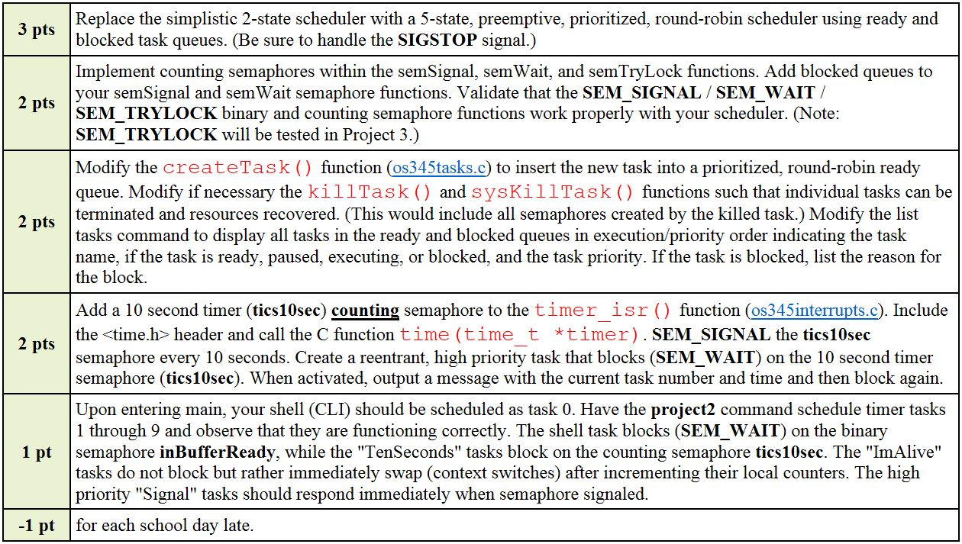
Project 2 Grading Criteria
Project 2

Slide 23
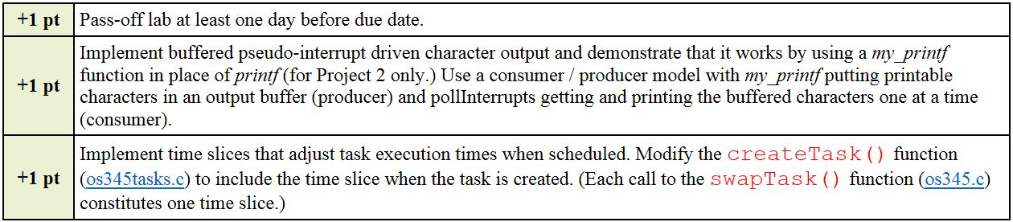
Project 2 Grading Criteria
Project 2
# | Task Name | Priority | Time slice | Blocking Semaphore
0 | CLI w/pseudo-input interrupts | 5 | 1 | inBufferReady
1-9 | TenSeconds | 10 | 1 | tics10sec
10 | sTask1 | 20 | 1 | sTask10
11 | sTask2 | 20 | 1 | sTask11
12 | ImAlive | 1 | 1 | None
13 | ImAlive | 1 | 1 | None

Slide 24
Project 2 Bonus Points
Project 2
Buffered pseudo-interrupt driven character output – my_printf
#include <stdarg.h>
void my_printf(char* fmt, ...)
{
va_list arg_ptr;
char pBuffer[128];
char* s = pBuffer;
va_start(arg_ptr, fmt);
vsprintf(pBuffer, fmt, arg_ptr);
while (*s) putchar(*s++);
va_end(arg_ptr);
} // end my_printf

Slide 25
Project 2 Bonus Points
Project 2
Task time slices
// schedule shell task
createTask( "myShell", // task name
P1_shellTask, // task
5, // task priority
argc, // task arg count
argv // task argument pointers
);
4, // task time slice

Slide 26


Slide 27
STDARG - Variable Arguments
Project 2
Usage:
#include <stdarg.h>
TYPE func(TYPE arg1,TYPE arg2, ...)
{
va_list ap;
TYPE x;
va_start(ap,arg2);
x = va_arg(ap,TYPE);
/* and so on */
va_end(ap);
}

Slide 28
VSPRINTF - Print Variable Arguments
Project 2
Usage:
#include <stdarg.h>
#include <stdio.h>
nout = vsprintf(str,format,varlist);
Description:
"vsprintf" is the same as "sprintf" except that it prints out a number of values from a variable argument list. The "varlist" variable must have been initialized with the "va_start" macro.
If there have already been calls to "va_arg" to obtain arguments from the variable list, "vsprintf" will start at the first argument that has not yet been obtained through "va_arg".
"vsprintf" effectively uses "va_arg" to obtain arguments from the variable list; therefore a call to "va_arg" after "vsprintf" will obtain the argument AFTER the last argument printed.
After a call to "vsprintf", the "varlist" variable should be assumed to be in an undefined state. If you want to use "varlist" again, you must call "va_end" to clean up, then "va_start" to reinitialize it.

Slide 30
SWAP (Context Switch)
// ***********************************************************************
// Do a context switch to next task.
// Save the state of the current task and return to the kernel.
// Return here when task is rescheduled.
void swapTask()
{ // increment swap cycle counter
swapCount++;
// either capture state and enter kernel mode (k_context)
// or resume execution by “return”ing
if(setjmp(tcb[curTask].context)) return;
// task context has been saved in tcb, set task state as “READY”
if(tcb[curTask].state == S_RUNNING) tcb[curTask].state = S_READY;
// enter kernel context and select highest priority ready task
longjmp(k_context, 2);
} // end swapTask

Slide 31
STDARG - Variable Arguments
Usage:
#include <stdarg.h>
TYPE func(TYPE arg1,TYPE arg2, ...)
{
va_list ap;
TYPE x;
va_start(ap,arg2);
x = va_arg(ap,TYPE);
/* and so on */
va_end(ap);
}
Description:
The beginning of the function definition uses the normal format to declare arguments that are always present. In addition, it uses an ellipsis (...) to stand for the variable part of the argument list. In its local declarations, the function should declare a variable of the type "va_list". This type is defined with a typedef statement in <stdarg.h>.
To begin processing the variable part of the argument list, you must issue the macro call va_start(ap,lastparm); where "ap" is the variable of type "va_list" and "lastparm" is the last named parameter (i.e. the one that immediately precedes the ellipsis).
To obtain an argument value from the variable part of the argument list, you use the macro call va_arg(ap,TYPE) where TYPE is the type of value that you want to obtain from the variable part of the argument list. The result of "va_arg" is an expression whose value is the next value from the argument list. For example, i = va_arg(ap,int); obtains an integer from the variable part of the argument list and assigns it to "i".
To finish processing the variable part of the argument list, you must issue the macro call va_end(ap); You can issue "va_end", even if you have not read every argument from the variable part of the list. After issuing "va_end", you can issue "va_start" again to go back to the beginning of the list and start over.

Slide 32
VSPRINTF - Print Variable Arguments
Usage:
#include <stdarg.h>
#include <stdio.h>
nout = vsprintf(str,format,varlist);
Where:
char *str;
points to the string where the output will be written.
const char *format;
is a standard "printf" format string.
va_list varlist;
is a variable argument list consisting of the values to be printed.
int nout;
is the number of characters output (not counting the '\0' on the end of the string). If the print operation failed for some reason, a negative number is returned.
Description:
"vsprintf" is the same as "sprintf" except that it prints out a number of values from a variable argument list. The "varlist" variable must have been initialized with the "va_start" macro. If there have already been calls to "va_arg" to obtain arguments from the variable list, "vsprintf" will start at the first argument that has not yet been obtained through "va_arg". "vsprintf" effectively uses "va_arg" to obtain arguments from the variable list; therefore a call to "va_arg" after "vsprintf" will obtain the argument AFTER the last argument printed.
After a call to "vsprintf", the "varlist" variable should be assumed to be in an undefined state. If you want to use "varlist" again, you must call "va_end" to clean up, then "va_start" to reinitialize it.

Slide 33
Task Dispatching
Lab 2
int dispatcher(int curTask)
{ int result;
switch(tcb[curTask].state) // schedule task
{ case S_NEW: // new task, start executing
tcb[curTask].state = S_RUNNING; // set task to run state
if(setjmp(k_context)) break; // context switch to new task
temp = (int*)tcb[curTask].stack + (STACK_SIZE-8); // move to new stack
SET_STACK(temp)
result = (*tcb[curTask].task)(tcb[curTask].argument); // begin execution of task
tcb[curTask].state = S_EXIT; // set task to exit state
longjmp(k_context, 1); // return to kernel
case S_READY: tcb[curTask].state = S_RUNNING; // set task to run
case S_RUNNING: if(setjmp(k_context)) break; // return from task
if (signals()) break;
longjmp(tcb[curTask].context, 3); // restore task context
case S_BLOCKED: break; // ?? Could check here to unblock task
case S_EXIT: if(curTask == 0) return -1; // if CLI, then quit scheduler
syskillTask(curTask); // kill current task
break;
default: powerDown(-1); // problem!!
}
return 0;
} // end dispatcher
Calls to Signal handlers inserted here…

Slide 34
Task Dispatching
Lab 2
int dispatcher(int curTask)
{ int result;
switch(tcb[curTask].state) // schedule task
{
case S_NEW: tcb[curTask].state = S_RUNNING; // set task to run state
if(setjmp(k_context)) break; // context switch to new task
temp = (int*)tcb[curTask].stack + (STACK_SIZE-8);
SET_STACK(temp) // move to new stack
result = (*tcb[curTask].task)(tcb[curTask].argument);
tcb[curTask].state = S_EXIT; // set task to exit state
longjmp(k_context, 1); // return to kernel
case S_READY: tcb[curTask].state = S_RUNNING; // set task to run
case S_RUNNING: if(setjmp(k_context)) break; // return from task
if (signals()) break;
longjmp(tcb[curTask].context, 3); // restore task context
case S_EXIT: if(curTask == 0) return -1; // if CLI, then quit scheduler
syskillTask(curTask); // kill current task
break;
default: powerDown(-1); // problem!!
case S_BLOCKED: break; // NEVER HAPPEN!
}
return 0;
} // end dispatcher

Slide 35
Step 1: Priority Queue
•••
Priority/TID
Priority/TID
Priority/TID
Priority/TID
# of entries
Create a priority queue
typedef int TID; // task ID
typedel int Priority; // task priority
typedef int* PQueue; // priority queue
Write queue functions to add/delete elements
int enQ(PQueue q, TID tid, Priority p);
int deQ(PQueue q, TID tid);
q # | pr1/tid1 | pr2/tid2 | …
tid >=0 find and delete tid from q
-1 return highest priority tid
int tid (if found and deleted from q)
-1 (if q empty or task not found)
typedef struct
{ int size;
union
{ int element;
struct
{ uint8 tid;
uint8 priority;
} entry;
} queue[100];
} PQueue;

Slide 36
Step 4: Counting Semaphore
P2 - Tasking
Implement counting functionality to semaphores
Add a 10 second timer (tics10sec) counting semaphore to the polling routine (pollInterrupts). This can be done by including the <time.h> header and calling the C function time(time_t *timer). semSignal the tics10sec semaphore every 10 seconds.
Create a reentrant high priority task that blocks (SEM_WAIT) on the 10 second timer semaphore (tics10sec). When activated, output a message with the current task number and time and then block again.

Slide 37
Step 5: List Tasks
P2 - Tasking
Modify the list tasks command to display all tasks in the system queues in execution/priority order indicating the task name, if the task is ready, paused, executing, or blocked, and the task priority. If the task is blocked, list the reason for the block.

